Slide 1


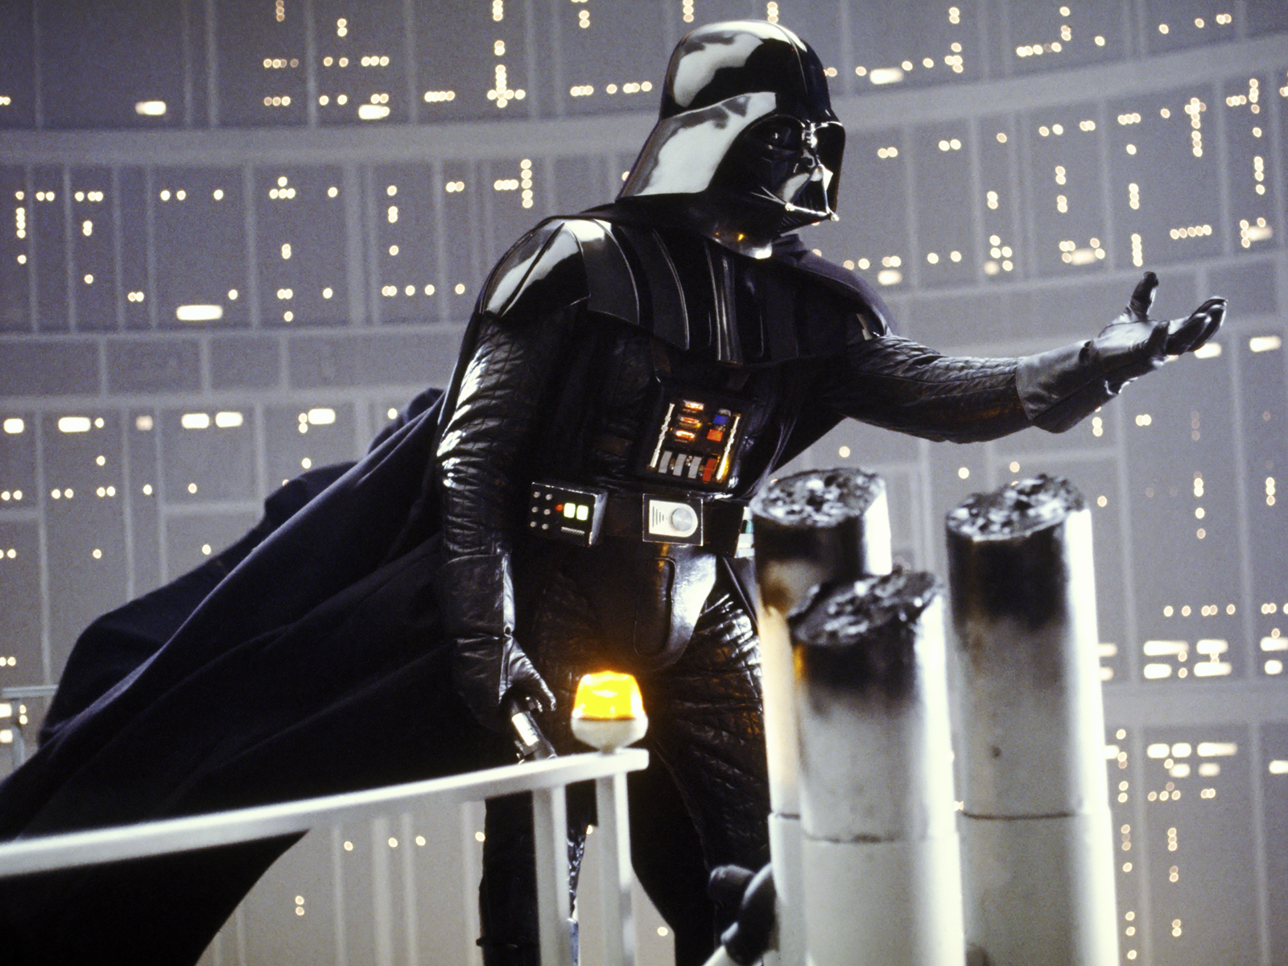
Jul, 8th | PARIS
The Dark Side of Social Media
Ferdinand Leube
DAFT May 22

Slide 2
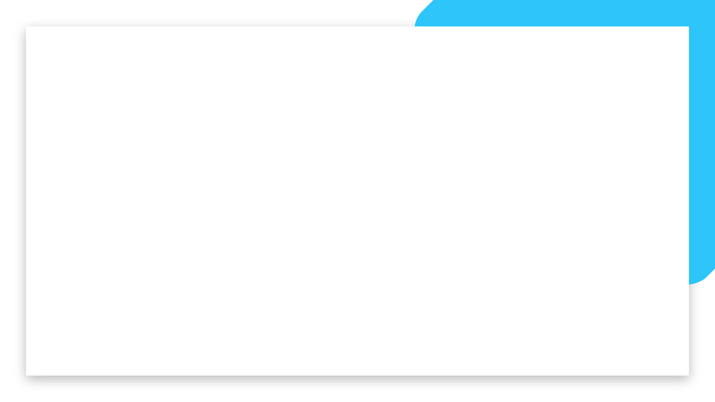

Business case
Domain
Impacts of social media on society and on gun violence in the US
Main Hypothesis
Through an early confrontation with violence and weapons on social media, children in current generation are getting used to this kind of content and are therefor less inhibited to use violent methods when facing a problem, dispute, struggling with mental illness etc.
To do
What factors might have an impact on/correlation with increase of gun violence?
Is Hypothesis supported by data analysis results?
How could we protect children from being confronted with such content?

Slide 3
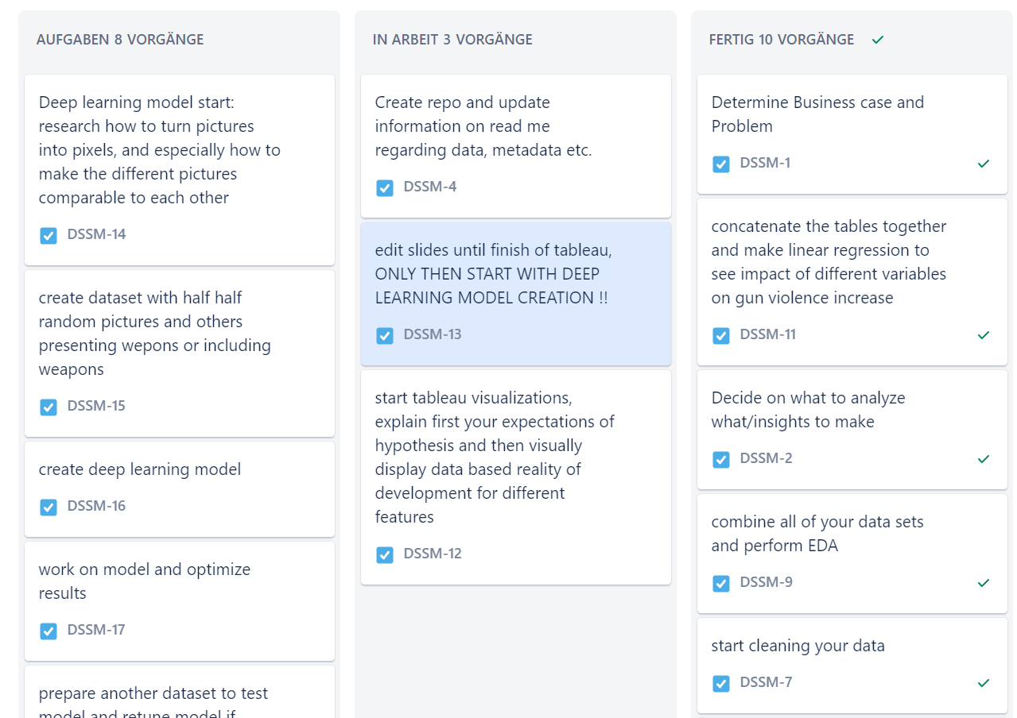
Plan
Data collection
Data cleaning
EDA
Preparing data for regression model
Running regression model
Analyze results
Build deep learning model
Presentation
Summary
Notes:
Step 4: to see feature importance/variable importance on gun violence development

Slide 4
About Data
Average monthly social media users
Open source data having API access to social media platfroms
Entity: social media platform
Gun violence in America
Source: gun violence archive
Location
Information on registered guns
Source: ATF → Bureau of Alcohol, Tobacco, Firearms and Explosives
Year
Number of killed
Number of wounded
Different types of registration forms
Focus on: number of imported and manufactored guns ATF_FORM_2
Date/Time
Year
Monthly users: monthly average visits of specific entity
Notes:
Step 4: to see feature importance/variable importance on gun violence development

Slide 5
About Data
Federal Firearms Licensees and Compliance Inspections
Source ATF → Bureau of Alcohol, Tobacco, Firearms and Explosives
Mental Health
Source: Our world in Data
Entity: country
Country code
Year
Multiple mentall Illnesses/disorders, and perentage of patients by total populaion
Year
Total licenses
inspections
Percent inspected
Notes:
Step 4: to see feature importance/variable importance on gun violence development

Slide 6
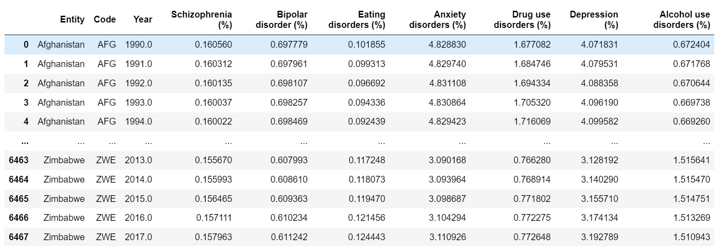
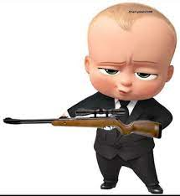
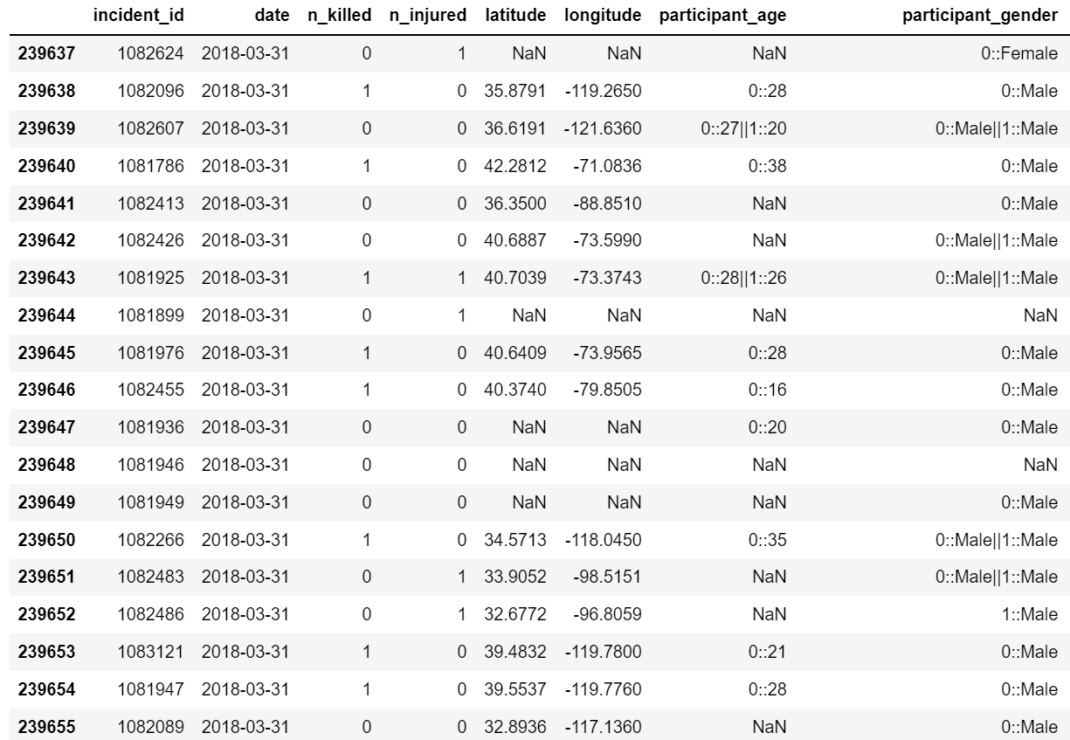
Raw Data Overview
Notes:
Step 4: to see feature importance/variable importance on gun violence development

Slide 7
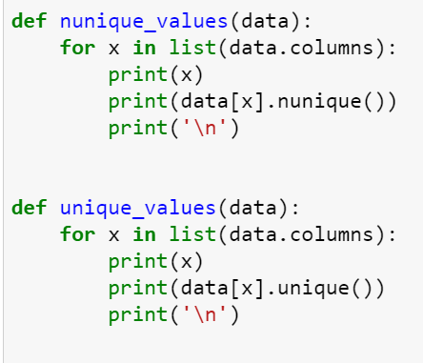
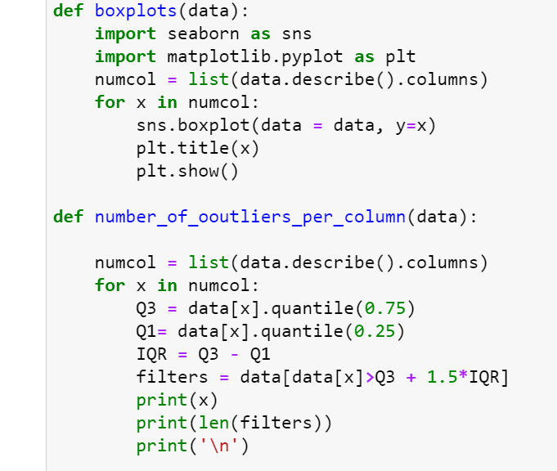
Data cleaning, data prep, EDA
Each step for every dataset:
Check general structure of the data
Select necessary columns
Collect values for US only
Group by year
Check for missing values and deal with them if existent
Notes:
Add pictures of cleaning methods, cleaning functions, time series models

Slide 8
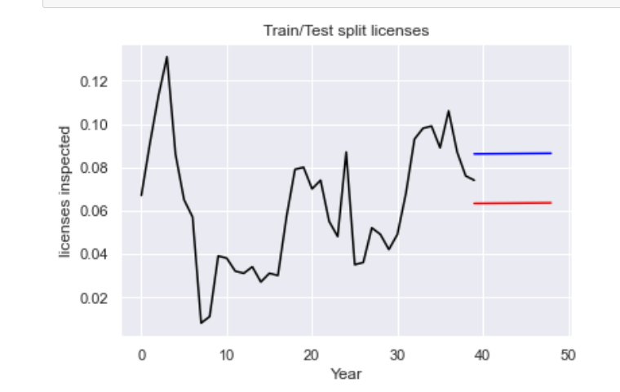
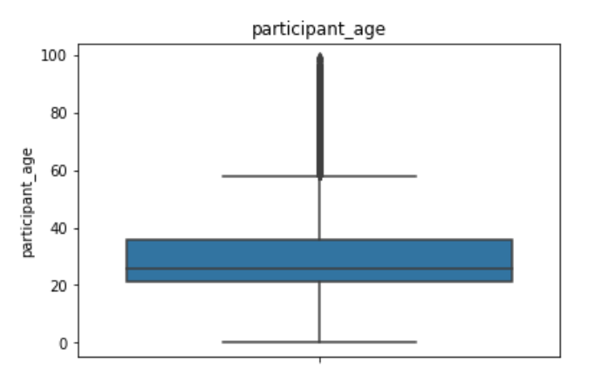
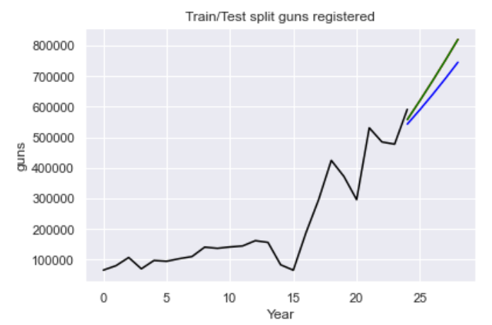
Data cleaning, data prep, EDA
Check for outliers, decide how to handle them
Collect data for comparable years
Use time series and linear regression to make forecast for values of missing years
Notes:
EDA examples, maybe make a few more (

Slide 9
Tableau Visualizations of Developments

Slide 10
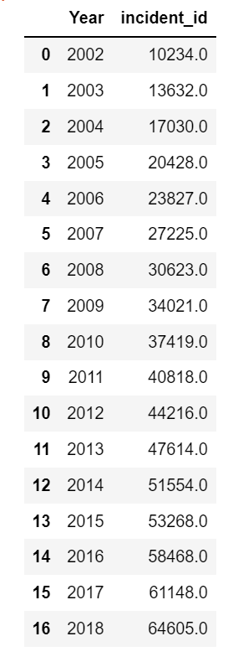
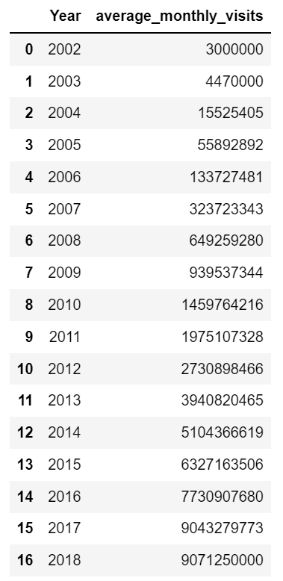
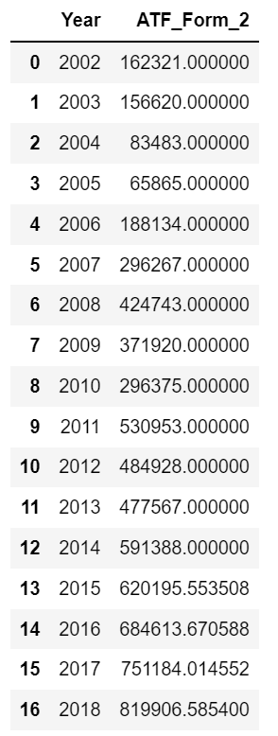
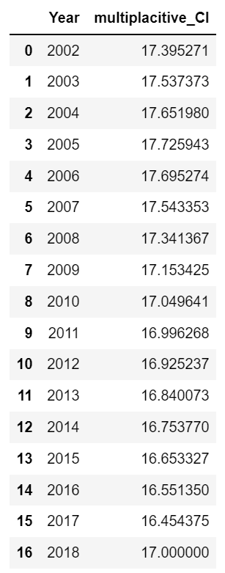
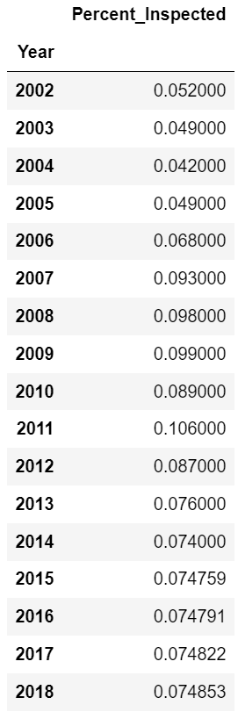
Data Cleaning Results

Slide 11
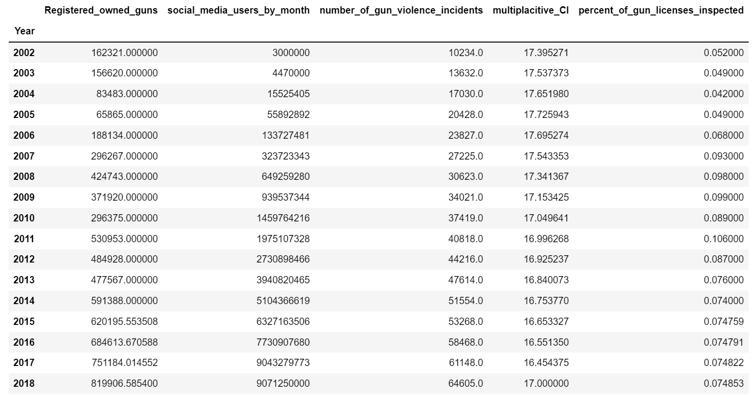
Linear regression model - Preparation
Set year column to index for all
Renamed columns
concatenated

Slide 12
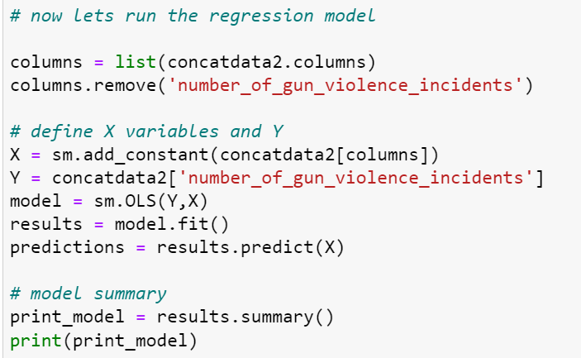
Linear regression model - Preparation

Slide 13
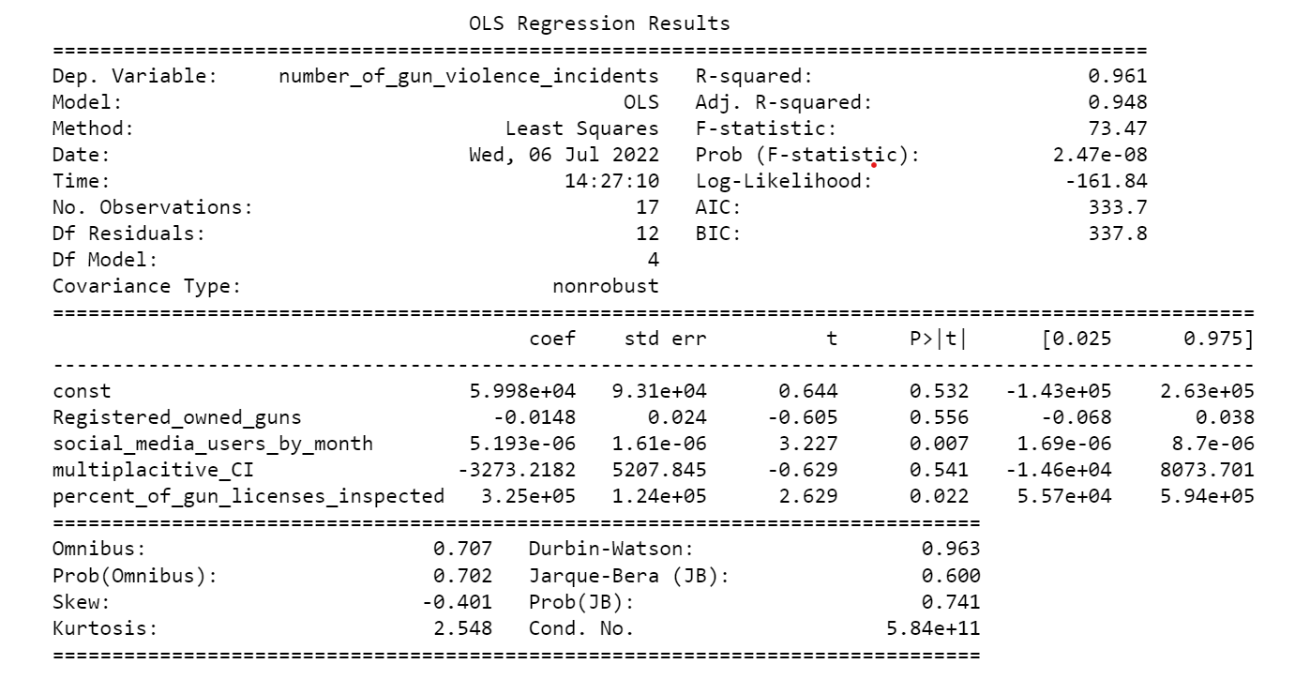
Regression model result
Notes:
high r squarred value --> good fit of the model describing almost all of the variance of the original data
model is statistically significant, high f or also called ANOVA statistic
different features have different significances on outcome of y variable
the lower the P|t| here the better because this is the result of hypothesis test, checking the variables significance, H0 in this case here is that the variable is unsignificant, the lower the value the better because with a significance of 5 maybe 10 percent, you will reject H0 for values below that level and accept H1 being that the tested varibale is significant for the outcome of the y variable
##########################################################
due to the statistical significance of social media users varibale for the gun violence development, we can assume that there might indeed be a correlation between the similar development of these to over the last couple of years
of course that is not the only feature having an impact on such a complex matter, there is a huge range of reasons for this develoment, but nonetheless it is a very interesting relationship that would be worth going into further detailed analysis
other variables having a significant impact:
inspected gun licenses:
research: gun laws have become a little stricter in the US over the last couple of years, also due to increasing gun violence concerns , therefor the statistical signifance can be explained because the trned is the same as the one of gun violence, both increasing over time, looking at the coefficient I would have expected a different outcome: a negative coefficient, you would expect that increased gun license checks and other gun laws enforcement being enforced simoutaniesly would reduce the gun violence, apparently this is not the case
a result that surprised me: mental health feature, no significance for the model, makes sense after previously analyzing the mental illness rate devlopment, 8n recent years only have mental illnesses have been recognized as such, further more mental illnesses did increase at a big rate afer the introduction of social media, but because such illnesses are being taken care of more serously and there are efforts made detecting these earlier, there has been a slow increase in mentall illness rate
also gun ownership unsignificant

Slide 14
How can we reduce the confrontation with wepons on socil media for children?
Notes:
high r squarred value --> good fit of the model describing almost all of the variance of the original data
model is statistically significant, high f or also called ANOVA statistic
different features have different significances on outcome of y variable
the lower the P|t| here the better because this is the result of hypothesis test, checking the variables significance, H0 in this case here is that the variable is unsignificant, the lower the value the better because with a significance of 5 maybe 10 percent, you will reject H0 for values below that level and accept H1 being that the tested varibale is significant for the outcome of the y variable
##########################################################
due to the statistical significance of social media users varibale for the gun violence development, we can assume that there might indeed be a correlation between the similar development of these to over the last couple of years
of course that is not the only feature having an impact on such a complex matter, there is a huge range of reasons for this develoment, but nonetheless it is a very interesting relationship that would be worth going into further detailed analysis
other variables having a significant impact:
inspected gun licenses:
research: gun laws have become a little stricter in the US over the last couple of years, also due to increasing gun violence concerns , therefor the statistical signifance can be explained because the trned is the same as the one of gun violence, both increasing over time, looking at the coefficient I would have expected a different outcome: a negative coefficient, you would expect that increased gun license checks and other gun laws enforcement being enforced simoutaniesly would reduce the gun violence, apparently this is not the case
a result that surprised me: mental health feature, no significance for the model, makes sense after previously analyzing the mental illness rate devlopment, 8n recent years only have mental illnesses have been recognized as such, further more mental illnesses did increase at a big rate afer the introduction of social media, but because such illnesses are being taken care of more serously and there are efforts made detecting these earlier, there has been a slow increase in mentall illness rate
also gun ownership unsignificant

Slide 15
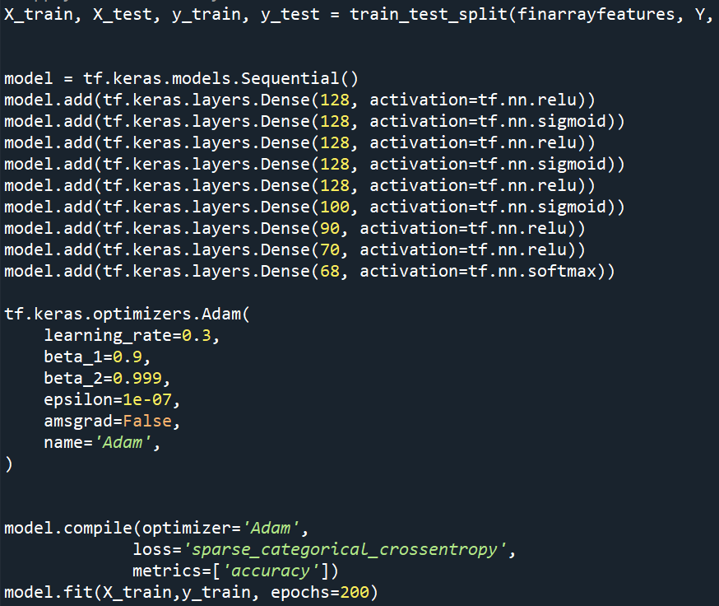
Model Preparation and Creation
Experiment with libaries such as pillow and matplotlib image libary etc.
Picture collection
Cleaning pictures, arranging picture matrix
Building model
Trying hyperparamter tuning
Consistently retrieved bad results, no matter the parameters
Decided I had to prepare my data in a different way
Notes:
Cleaning pictures:
Rearrange the pictures to the same size, then flattening to one dimensional array, create a numpy matrix consisting of the 1 dimensional picture array
Standardize/scale the arays to make the values more comparable and eassier to classify or the compter
Create the labels array corresponding to the pictures if they include a weapon or not
Create model → hyperparameter testing → read that for deep learning ist empirical, so playd with amount of hidden layers, amount of neurons, activation functions, creating own optimizer, learning rate,

Slide 16
Pixel organization and manipulation

Slide 17
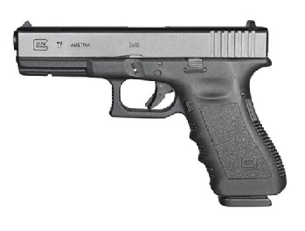
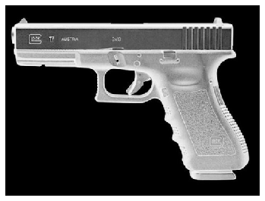
Grey shading
Notes:
calculate the weighted mean of the 3 RGB values
Transforms a colour image to a greyscale image by taking the mean of the
RGB values, weightedby the matrix weights

Slide 18
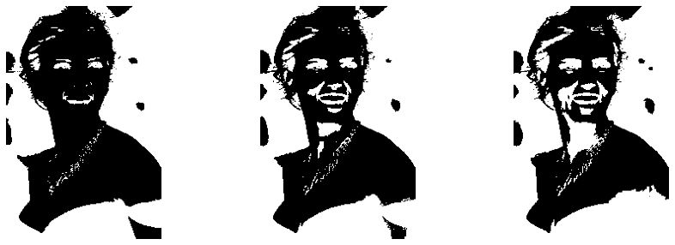
Threshholding
Notes:
you define a certain threshhold, all pixels with bigger value belong to one
class, all with lower or equal than threshhold below to other cluster

Slide 19
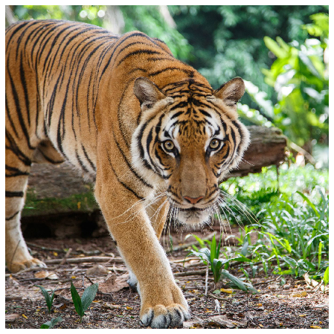
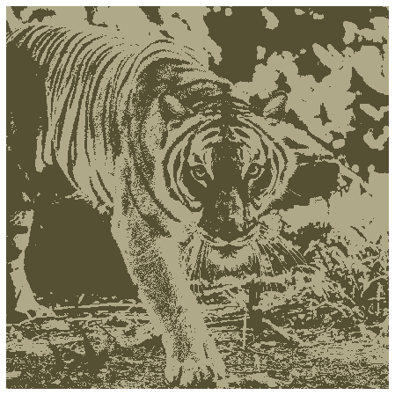
Clustering pixels using KMEANS
Notes:
create n clusters of pixel groups , which pixels per group are most similar in
numbers to each other
after clustering you select the pixel number for each cluster center and
reshape it back to the size of the original picture, then giving you a same
sized picture with only the colors of your determined cluster centers
the pixels assigned to the one cluster will be replaced by the central pixel
of that cluster, same with all other clusters has

Slide 20

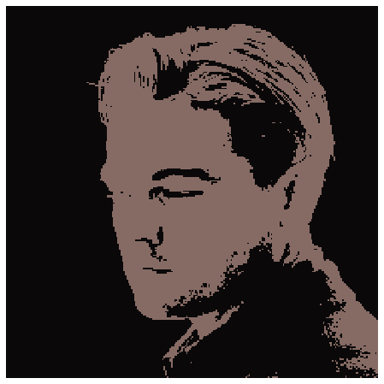
KMEANS selecting nth most typical color
Notes:
you can then select n^th most common color to be shown and all other will just be
black then

Slide 21


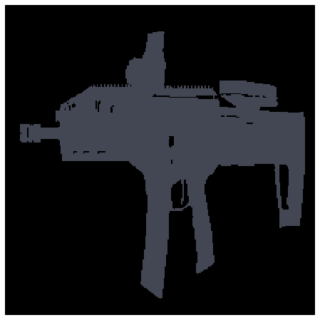

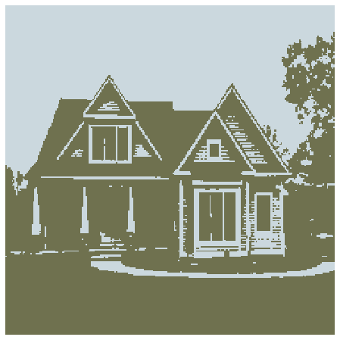
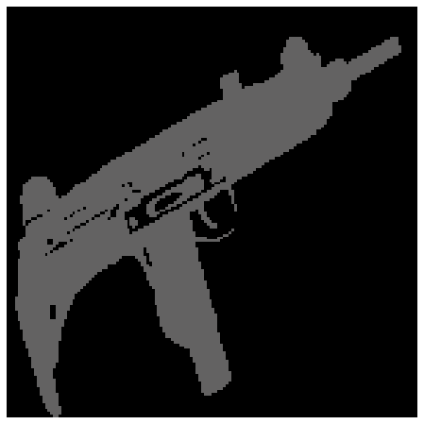
Model Preparation and Creation
Restructuring picture data by experimenting with the arrangement of pixels
Rerunning models
Comparing results
Applying external datasets and predicting
Notes:
, show

Slide 22
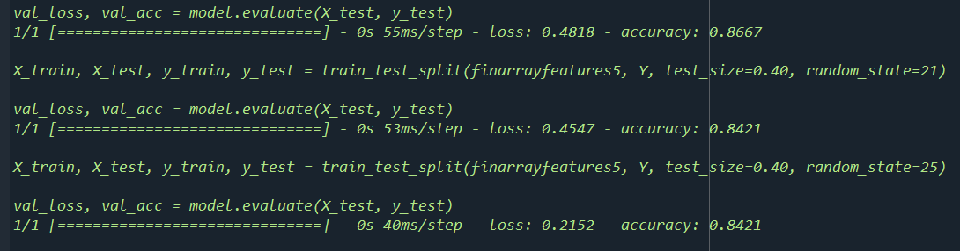
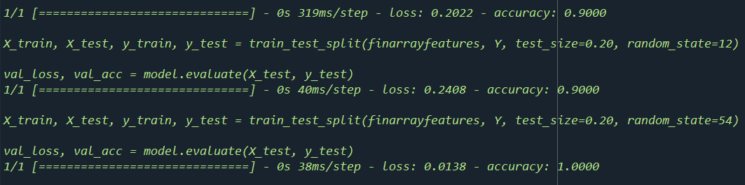
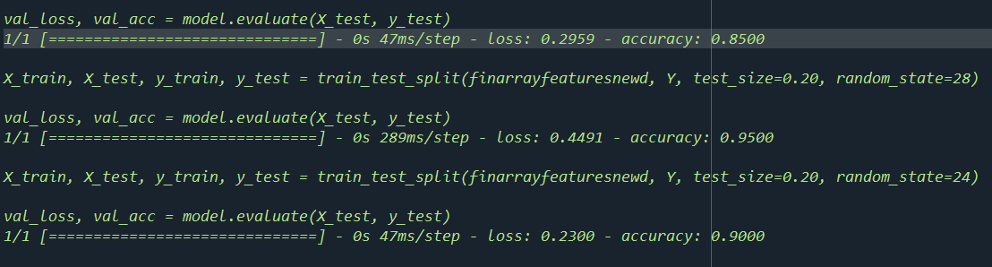
Main results
Notes:
Highest result with kmeans clustering

Slide 23
Conclusion
From the results of my regression model we can conclude that there are dependencies between the increase in social media usage and the increase of gun violence in the United States
Deep learning models are an effective way of filtering out unappropiate content and can be transfromed into a platform application such as e.g a safe mode that could be switched on on instagram, filtering out weapon related content

Slide 24

Thanks for listening !!!

Slide 25
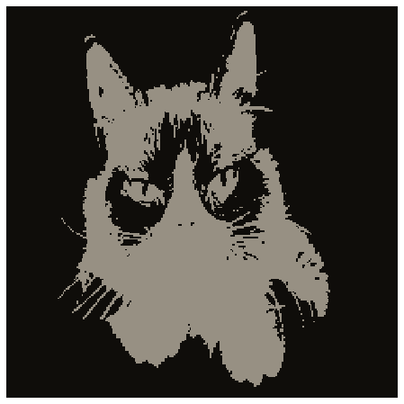
The Dark Side of Social Media
Ferdinand Leube
Questions?
(rearranged cat for Kseniia)

